Slide 1

SubReddit Post Virality Prediction
Animesh Parihar Tooba Khan Ritik Jain
2021JCS2235 2021JCS2245 2021JCS2260

Slide 2
Our work is focussed on predicting the virality of a post on reddit (within a subreddit) . Existing Research has delved into predicting content virality within relationship-based networks such as Facebook.
We explore virality prediction on Reddit, a content-driven network lacking a naturally-defined relationship between users.
In Reddit the post’s exposure is governed by a combination of
=> Post timing
=> Quality of a post’s content and title
=> Affinity between content and subreddit
=> Several other factors
Introduction/Motivation/Problem-Definition

Slide 3
Along with the above general features there is a possibility that predicting a post’s virality may depend on the network of user-user interactions .So to
include those features we’ve made a graph of user-user interaction.
We’ve build a model for virality prediction using the temporal(date and time), linguistic ( the title) and structural features of the Reddit user-user network on predictive ability.
Some of the other features of post such as score and number of comments were also included in our model.
Introduction/Motivation/Problem-Definition

Slide 4
Workflow
Linguistic(Title)
Temporal(Date and Time)
Others (No. of comments,
Post Score)
Training
the
Model
Data Collection
Extracting
Features
Creation of Graph
(Structural Features)
User id ,
Post id

Slide 5
Related Work/ Literature Survey
➔Cheng et al. did the prediction by incorporating temporal, structural, and content features into its model which provided a useful framework to build our model.
➔Lakkaraju et al. model takes into account the content of the submission, the title of the submission and community in which it is posted and demonstrate a set of features that are useful in virality prediction many of these will also prove useful in our task.

Slide 6
Related Work/ Literature Survey
In this paper the authors have discussed an algorithm for classification problem for credit card holders to predict whether he/she will default or not.
[Schonlau, M. and Zou, R. Y. (2020) ‘The random forest algorithm for statistical learning’, The Stata Journal, 20(1), pp. 3–29. doi: 10.1177/1536867X20909688.]
For studying about neural networks for prediction of scores we referred to the following paper:
[Nguyen Nghiep & Cripps Al (2001) Predicting Housing Value: A Comparison of Multiple Regression Analysis and Artificial Neural Networks, Journal of Real Estate Research, 22:3, 313-336, DOI: 10.1080/10835547.2001.12091068]

Slide 7
Collection of Data
Used publicly available PushShift Dataset.
Data available was in the form on json
Extracted the submissions and comments data of January 2020.
For submission entry, we have used title,URL,author,submission id,score,created time,number of comments and permanent link.
For comments entry, we have used id, link id, author, created time.

Slide 8
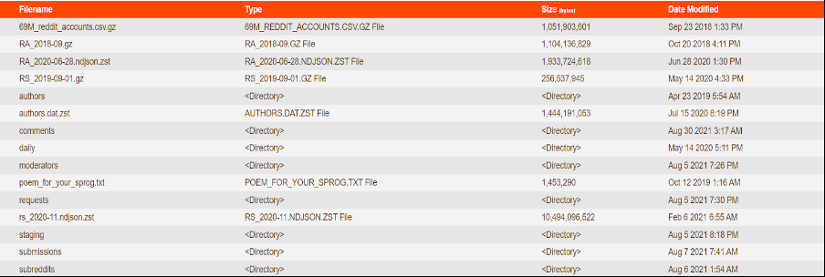
Collection of Data
Reddit pushift API snapshot.

Slide 9
Representing Reddit posts as a network
We have created a directed graph using Networkx
Each node of the graph represents a user
A user can have multiple posts in the given time frame.
However, many users in the network will be such that they will have 0 posts but their existence in the graph will be because they have commented on some post(s).
Reddit also allows comments on posts to gain virality and become even more viral than their original posts
All such cases have been included.

Slide 10
Representing Reddit posts as a network
A directed edge [u,v] means that user ‘u’ commented on any post of user ‘v’.
This post should however be in the selected time frame.
We have saved our graph consisting of 212842 nodes and 373026 edges as a gexf file.
Out of this 21375 nodes are the ones which are authors of posts. Others are people who have commented on any one of these nodes.
A snapshot of our graph is on the next slide.

Slide 11
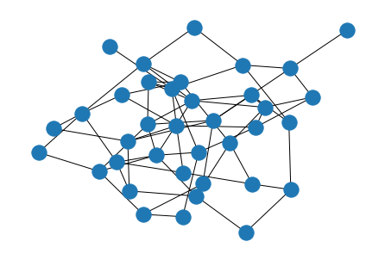
Representing Reddit posts as a network
Graph of reddit authors and posts in the month of January, 2020:

Slide 12
Aut. 3
Aut. 4
Post A4
Aut. 6
Post A6
Com.A6
Aut. 7
Post A7
Aut. 2
Post A2
Post B2
Com.A2
Aut. 9
Post A9
Aut. 5
Post A5
Aut. 12
Post A12
Aut. 8
Post A8
Com. A8
Aut. 10
Post A10
Aut. 11
Post A11

Slide 13
Feature vector
Our next step was to create a feature vector which could capture all the details of a given post.
For this purpose, first we ran Page Rank and degree centrality algorithms.
We calculated pageRank and degree centrality of each node to capture its significance in the network.
The third attribute was sentiment analysis of the post title.
For each post we ran sentiment analysis on the title of the post.
We stored the sentiment score of each title as an attribute.

Slide 14
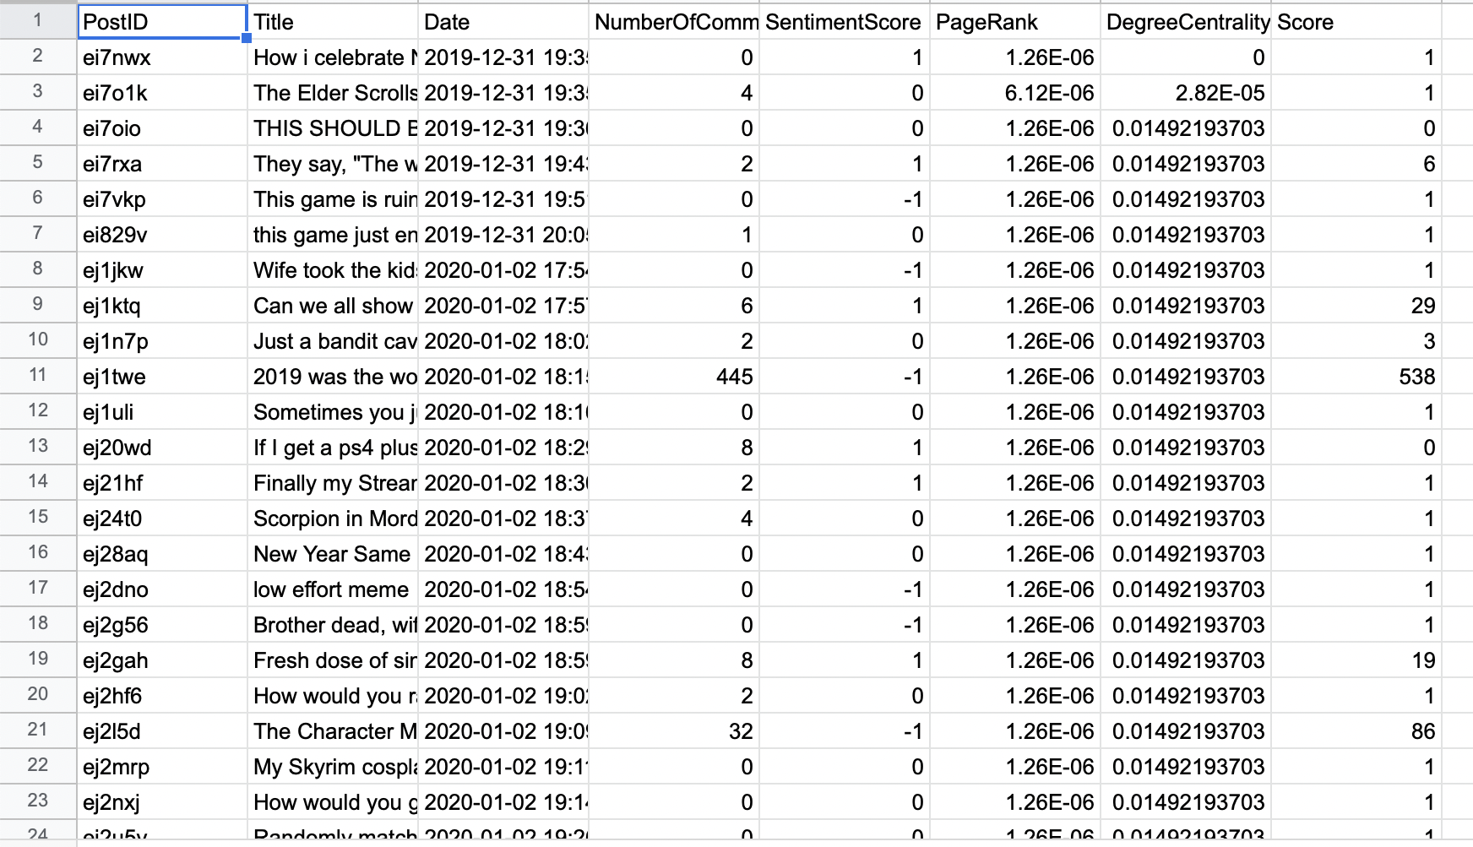
Feature vector for ML
FInally our feature vector had the following attributes:
Sentiment score
Page Rank of parent node
Degree centrality of parent node
Time stamp of the post
Number of comments
Score of the post

Slide 15
Prediction of Virality
Steps done till now:
Data collection
Graph creation
Collection of important attributes
Creation of feature vector
Finally, our last step was to create a prediction model which could predict if the given post would become viral in the chosen subreddit or not.
We implemented this in two ways:
Binary prediction
Neural network

Slide 16
Implementation of Classification Model
We implemented RandomForestClassifier which is a binary classification model.
Out of the available data, we have used 80% for training and 20% for testing.
We fixed a threshold of score = 5
By this we mean, that posts which have score >5 are considered viral and others are not.
Viral posts will have an output = 1
Non viral posts will have output = 0
For this we achieved train accuracy = 99.94% and test accuracy = 88.12%
The confusion matrix is on the next slide.

Slide 17
Implementation of Classification Model
Confusion matrix
Predicted→ Actual | 0 | 1 | All
0 | 3889 | 436 | 4325
1 | 269 | 1653 | 1922
all | 4158 | 2089 | 6247

Slide 18
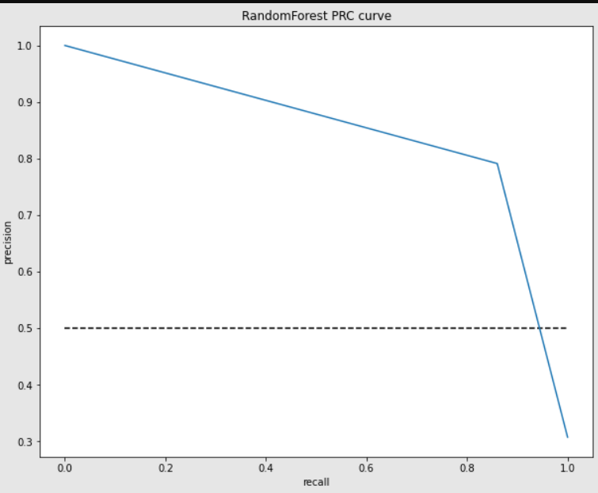

Slide 19
Prediction using Neural Network
We implemented a neural network using keras.
Out of the available data, we have used 80% for training and 20% for testing.
Now we y_train and y_test will be the actual score.
Model is trained to predict score for a given post and not it’s virality.
For this we achieved train accuracy = 94.48% and test accuracy = 94.67%
Due to less data, the neural network model did not perform very well.
There are a very instances of high scores and we couldn’t achieve a low loss from the training.

Slide 20
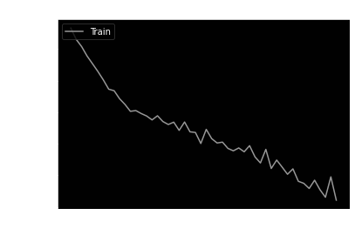
Prediction using Neural Network
Loss as a function of epochs:

Slide 21
Idea behind two kinds of models?
Notion of virality can vary
For some, virality can mean if the score > mean score of all posts
For others, it can mean that score exceeds a certain value.
We wanted to see how well our network model works on both kinds of implementations
Thus, the classification model is useful in cases where notion of virality is predefined
But neural network model is more relevant in cases where we want to estimate the score a post can achieve and then decide if that score implies virality or not.

Slide 22
Conclusions
We did a comparison between predictions using classification and neural network.
The classification model gave us quite good results which solved the aim of our project which was to predict virality.
Our dataset was made using only 1 month’s data and this is why our neural network did not give us good results.
Due to a small dataset, we got very few posts which had high scores.

Slide 23
Future Work
Given better resources, we can collect a larger dataset of at least a year.
On that dataset, predicting not only the virality but also the probable score that the project would achieve can give us good results.
We aimed at achieving second point also but given the small dataset we couldn’t get good results.

Slide 24
Thank you!

